Slide 1
To Study Different Lexical Automatic Machine Translation Evaluation Metric for Indic Languages.
Submitted in the partial fulfillment for the award of the degree of
BACHELOR OF ENGINEERING
IN
Computer Science specialization in Artificial Intelligence and Machine Learning
Submitted by:
Ankit Ghosal – 20BCS6621
Ayush Raj – 20BCS6612
Lalit Bisht - 20BCS6609
Divya Prem – 20BCS6618
Under the Supervision of:
Shweta Chauhan Ma’am
Department of AIT-CSE
DISCOVER . LEARN . EMPOWER

Slide 2
Outline
Introduction
Problem Formulation
Objectives
Methodology used
Evaluation Metrics
Results and Outputs
Conclusion
Future Scope
References

Slide 3
Introduction
With the rapid growth of globalization and the increasing need for multilingual communication, machine translation has become an essential tool for overcoming language barriers.
However, evaluating the accuracy and effectiveness of machine translation is a complex task, particularly for Indic languages, which are among the most widely spoken languages in the world.
In recent years, several lexical automatic machine translation evaluation metrics have been developed to address this challenge, but there is still much room for improvement.

Slide 4
The aim of this study is to explore different lexical automatic machine translation evaluation metrics for Indic languages and analyze their effectiveness. We will examine the various metrics currently used in Indic languages such as Hindi, Bengali, Tamil, and others, and compare them to the metrics used in other languages.
The study will contribute to the development of more accurate and effective machine translation evaluation metrics for Indic languages, which in turn will facilitate better communication and understanding among people speaking different languages.

Slide 5
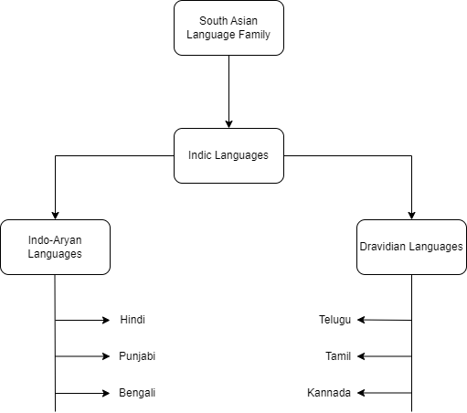
Fig. Family tree of Indic languages

Slide 6
Problem Formulation
Automatic machine translation (MT) systems have gained much popularity and are widely used for communication between people who speak different languages. However, evaluating the quality of machine translation systems is a challenging task, especially for Indic languages.
Several evaluation metrics have been proposed to evaluate the quality of machine translation systems. However, these metrics may not be suitable for Indic languages due to the differences in language structure and complexity. Therefore, the need for developing and testing different lexical automatic machine translation evaluation metrics for Indic languages arises.

Slide 7
Objectives
The objective of this study is to explore and compare different lexical automatic machine translation evaluation metrics for Indic languages. The study aims to address the following research questions:
What are the existing lexical automatic machine translation evaluation metrics for Indic languages?
What are the different lexical automatic machine translation evaluation metrics that can be used for Indic languages?
How do the different evaluation metrics compare in terms of accuracy and efficiency for Indic languages?

Slide 8
Methodology used
The following is a suggested methodology for studying different lexical automatic machine translation evaluation metrics for Indic languages:
Literature review
Data collection
Metric selection
Data analysis
Metric modification
Guideline development
Conclusion

Slide 9
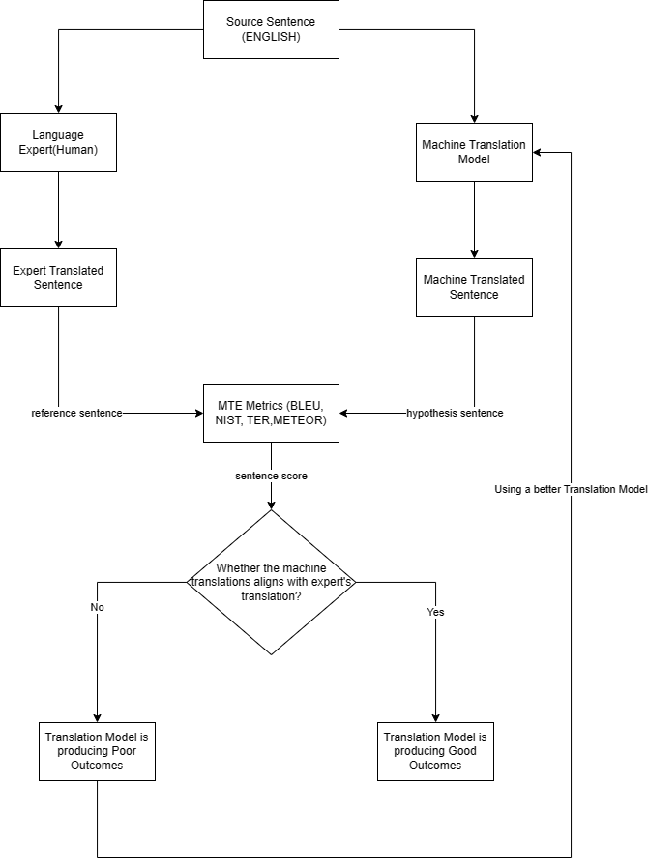

Slide 10
Evaluation Metrics
Bilingual Evaluation Understudy (BLEU)
BLEU works by comparing the n-grams (sequences of n words) of the candidate translation with those of the reference translations. For each n-gram size (usually from 1 to 4), BLEU calculates a modified precision score, which is the ratio of matching n-grams to the total number of n-grams in the candidate translation.
National Institute of Standards and Technology (NIST)
NIST (National Institute of Standards and Technology) is an organization that evaluates the performance of natural language processing (NLP) systems through the development of benchmark datasets and standardized evaluation metrics. NIST differs from BLEU in two main aspects: how it calculates n-gram precision and how it applies the brevity penalty.

Slide 11
Metric for Evaluation of Translation with Explicit Ordering (METEOR)
The Metric for Evaluation of Translation with Explicit Ordering (METEOR) is a machine translation evaluation metric that aims to measure the quality of machine translation results in a way that aligns with human judgments of translation quality. This is accomplished by comparing the output of the machine translation to one or more reference translations and assessing the output's quality using a mix of precision, recall, and alignment error .
Translation Error Rate (TER)
TER (Translation Error Rate) is a metric commonly used in Natural Language Processing (NLP) to evaluate the quality of machine translation output. TER is a distance-based metric, which means it calculates the edit distance between the machine-generated translation and the reference translation.

Slide 12
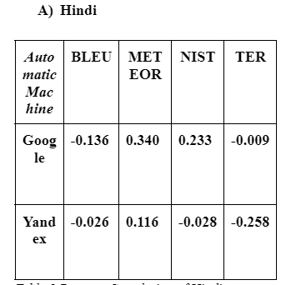
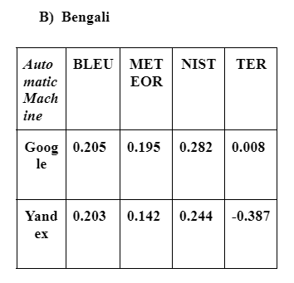
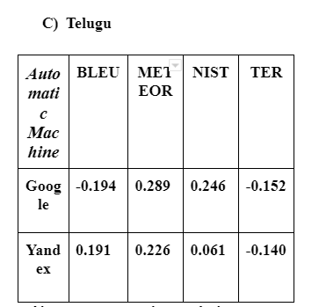
Results and Outputs

Slide 13
Conclusion
In conclusion, the study aimed to explore various lexical automatic machine translation evaluation metrics for Indic languages. Several famous on their effectiveness in assessing the quality of the machine-translated text. The evaluation was carried out on multiple datasets, and the results were analyzed to determine which metric performed better.
The study recommends using a combination of BLEU, METEOR, and TER metrics to evaluate machine translation systems for Indic languages. This approach provides a more comprehensive evaluation and a better understanding of the quality of the machine-translated text. Additionally, the study suggests that future research should focus on developing new evaluation metrics specifically for Indic languages to improve the accuracy and effectiveness of machine translation evaluation.

Slide 14
Future Scope
In this paper, we have presented a comparative analysis of different lexical automatic machine translation evaluation metrics for indic languages. We have evaluated the performance of these metrics on three different datasets of English - Hindi, English - Bengali and English - Telugu translation pairs.
As a future work, we plan to extend our study to other Indic languages and domains. We also aim to incorporate syntactic and pragmatic features to capture the structural and contextual aspects of translation quality. Furthermore, we intend to explore the correlation of the metrics with human judgments and conduct a user study to validate its usefulness and reliability.

Slide 15
References
[1] Papineni et al., "BLEU: a Method for Automatic Evaluation of Machine Translation", ACL 2002.
[2] Doddington et al., "Automatic Evaluation of Machine Translation Quality Using N-gram Co-occurrence Statistics", HLT 2002.
[3] Callison-Burch et al., "Re-evaluating the Role of BLEU in Machine Translation Research", EACL 2006.
[4] Wang, S., Liu, C., & Wei, F. (2020). Learning to Answer by Learning to Ask: Getting the Best of GPT-2 and BERT Worlds. arXiv preprint arXiv:2010.00459.
[5] Le, H., Nguyen, N. T., & Nguyen, T. H. (2021). BERT-based Lexicalized Topic Models for Political Text Analysis. arXiv preprint arXiv:2101.06379.
[6] Snover, M., Dorr, B., Schwartz, R., Micciulla, L., & Makhoul, J. (2006). A study of translation error rate with targeted human annotation. In Proceedings of the 7th Conference of the Association for Machine Translation in the Americas (pp. 223-231).
[7] Bawden, R., Gašić, M., & Mrkšić, N. (2018). Improving lexical choice in neural machine translation. arXiv preprint arXiv:1808.09381.

